Slide 1
Walletkeeper
钱包管家
Group 15:
ZHOU Ziyang (55921210)
FANG Yuxin(55941269)
LI Huimin (55997947)
SHEN Yaojun (55988822)
ZHANG Jianing (55831831)

Slide 2
目录
CONTENT
1
Background
2
Market Research
背景
市场调查
3
Expected Functions
4
Design Details
预想功能
具体方案

Slide 3
PART ONE
Background
Diversified consumption
Over-spend
Convenient mobile payment method makes people spend more before
The young generation have high enthusiasm for consumption which leads to their incomes and expenses is unmatched

Slide 4

Objectivs
Compare prices of an item through your record
Do not pay unnecessary money
Increase you sense of investment
Manage your property appropriately
Keep balance of payments
Rational consumption
once you have formed the bookkeeping habit, you can find many other benefits which can improve your living standard.

Slide 5



PART TWO
Market Research
Bookkeeping apps are not significantly different in the overall architecture, even very similar in user interface design and report output. However, in terms of function selection and operation optimization, there are still differences.
The following is a selection of three bookkeeping app, Daily Cost, Shark Accounting, and Fortune City for comparison and analysis.
Daily Cost
Shark Accounting
Fortune City

Slide 6
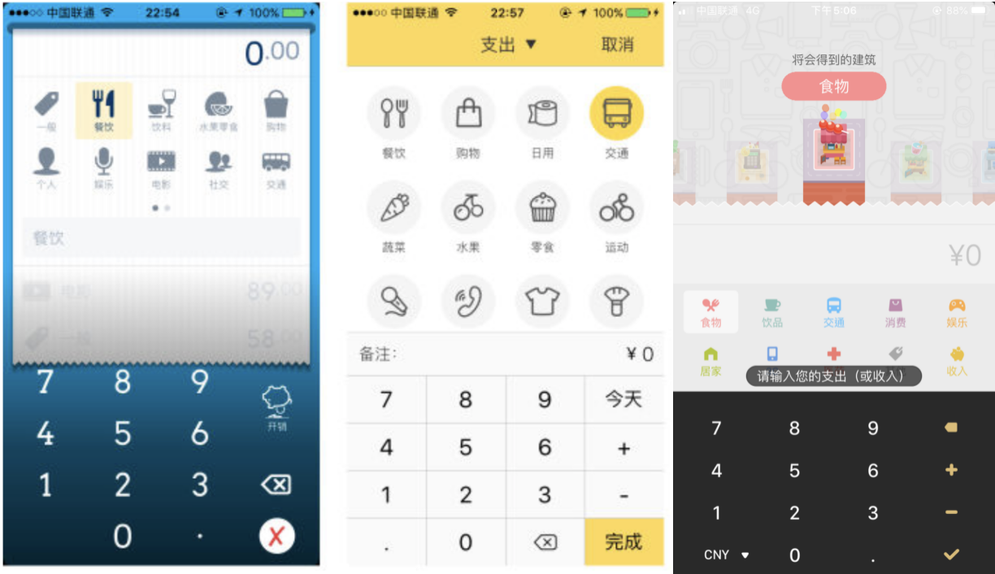
Daily Cost
Provide multiple currencies as unit of account
Shark Accounting
No independent user system in app
Notification setting
Features
Fortune City
Combine accounting with simulation games
UI

Slide 7
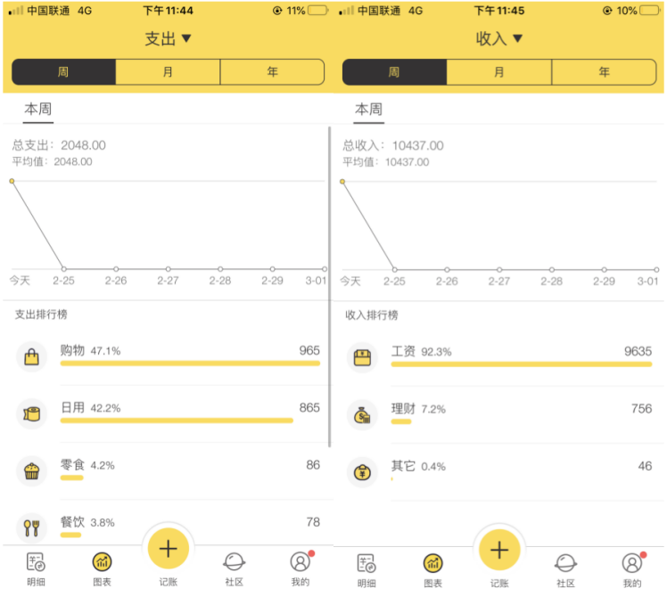
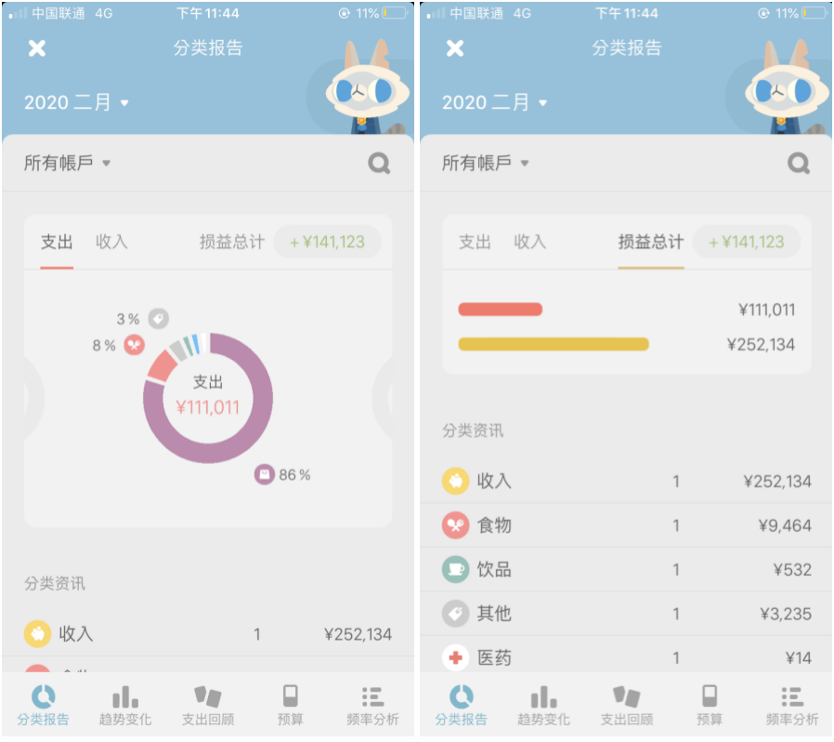
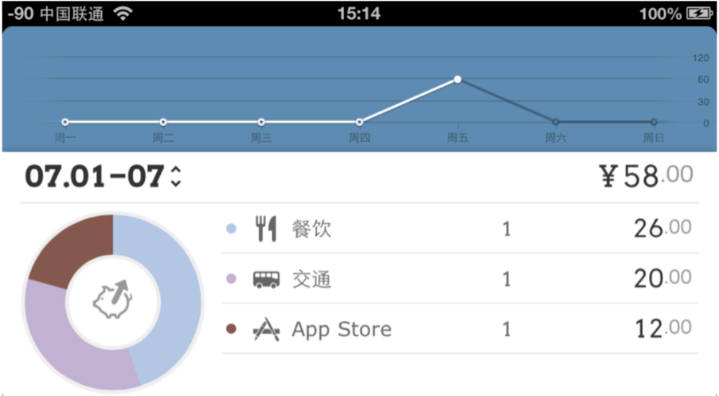
Daily Cost
It also uses line charts and pie charts to list the bill details in units of days.
Shark Accounting
Mainly uses line charts, but you can query spending trends by week, month, or year.
Account Statement
Fortune City
It uses histograms and pie charts.

Slide 8
PART THREE
Expected Functions
Basic bookkeeping function
Record your expense and income
GPS function
Trace when you have record this bill and where you have record this bill
Wish list
Help you to save money and achieve goal

Slide 9
PART Four
Design details
Methodology
Development Platform
Use Case
User Interface

Slide 10




Methodology
We will use Android Studio as development tool,and calling SQL database, use java as the develop language. Apply the Wechat OAuth2.0 authorized to log in the app, and use the plug-in rxjava to organize and calculate the bills.

Slide 11

Development Platform
Android
Android is a, developed by the Open Handset Alliance, Linux-Kernel NetBSD-Userland based operating system for Smartphones, Tablets and other mobile devices, as well as other embedded devices, like cars. It is widely used in app developing. In the 4th quarter of 2015, Android had a market share of over 80 % (80.7 %) in the distribution of operating systems in of mobile operating systems

Slide 12
Advantages
A
Open system creates a free environment without over-regulation that allows any developers to join Android Market and develop their own apps.
B
Due to the openness of Android, many developers will launch a variety of products with various functions and unique features, and data can be transferred easily.
The mainstream development language of Android is Java language, it is a simple, universal, object-oriented, secure, portable, and high-performance language.
This app ecosystem is attractive to both customers and developers alike. With the increasing number of users and apps, the platform is mature
C
D

Slide 13

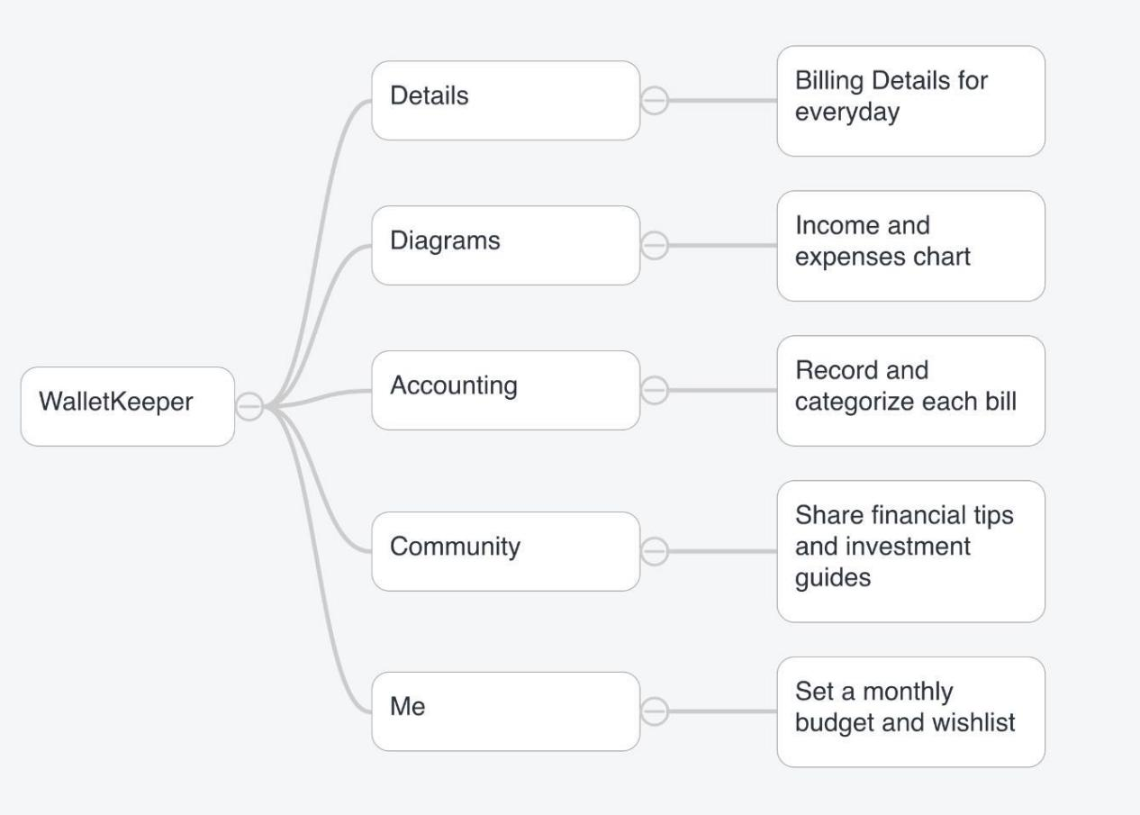
Use Case
It contains five main functions:
accounting, diagrams,details,community,me
Use Case Diagram
The accounting function is record the bill details including the category, price and the location in time.The details function is show the details for each bills the user recorded in accounting function.The third function is the diagrams function,which use the chart to show the change of daily income and expenses directly.In the community function,users can post their wishlist or share the financial tips on that,they can also read others article about investment guides to accumulate wealth and achieve the wish in wishlist faster.In Me function,users can set their monthly budget and set the wishlist here,at the same time, this function will show the details about budget(remain budget,monthly budget,expenses in this month).

Slide 14
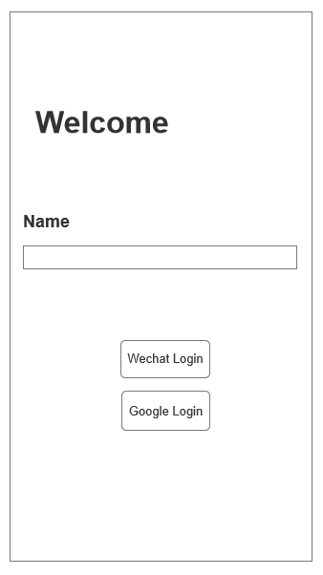
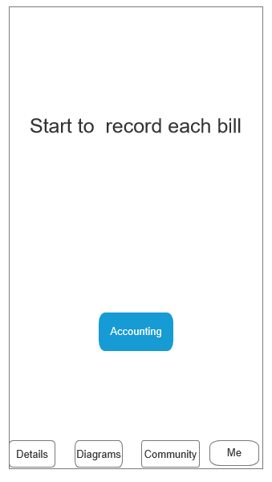
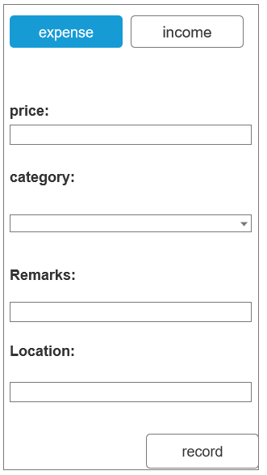
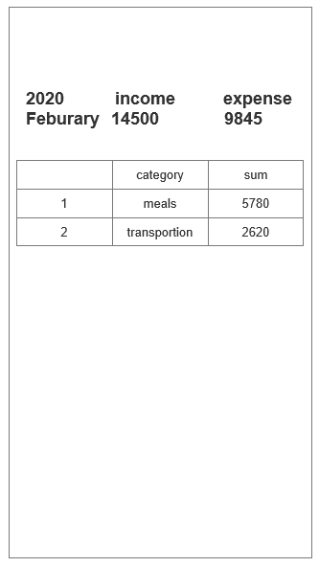
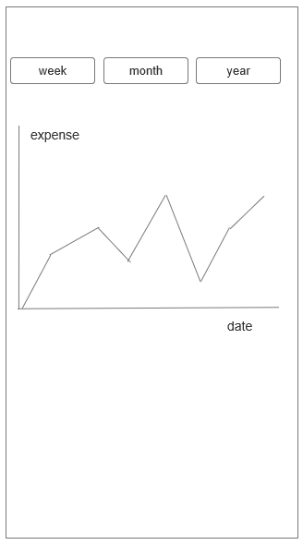
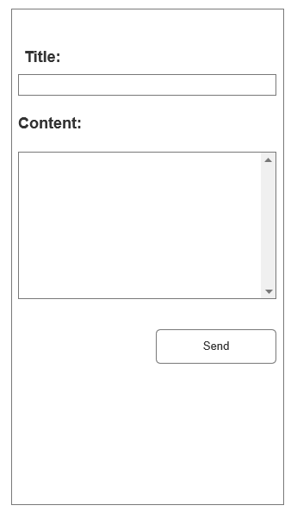
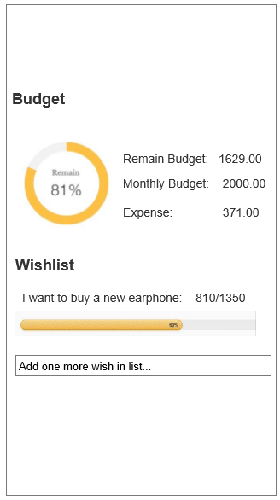
User Interface
(1)Login: Users choose to Wechat login or Google login, then enter this app. (2)Home: The default home page of this app
(3)Accounting function: Users record the details about the expense or income, remarks and location(GPS).
(4)Details function: Users can see the sum of income and expenses this month and the total bills for each category. (5)Diagrams function: This function show the expense daily in the form of a line chart
(6)Community function: Users can post their ideas or share their bill in this community.
(7)Me function: Users can set the budget and wishlist.

Slide 15
Thanks

